Slide 1
Analyzing best venue to open a mall in Mumbai
By
Shreyas Dronamraju

Slide 2
Introduction
A shopping mall is a modern, chiefly North American, term for a form of shopping precinct or shopping center in which one or more buildings form a complex of shops with interconnecting walkways, usually indoors. Shopping malls these days are on stop destinations due to their versatility of covering eating, shopping, entertainment and other leisure activity.
Various parameters are taken into concern when building a shopping mall. One of the most important of these parameters is the location of the mall. Hence this report will be dealing with analyzing and selecting the best location to open a mall in Mumbai. The project will be useful for builders to select a location to build a mall. A secondary benefit is that it can also help people look at the areas with the most malls in the city

Slide 3
Business problem
Which is the best location to open a mall in Mumbai?

Slide 4
Data
List of neighborhoods in Mumbai data via Wikipedia defines the scope of this project which is confined to the city of Mumbai.
Python Geocoder package for latitude and longitude coordinates of the neighborhoods in order to plot the map and also to get the venue data.
Foursquare API to get the venue data for the neighborhoods.
Python Folium Package for Map Visualization.

Slide 5
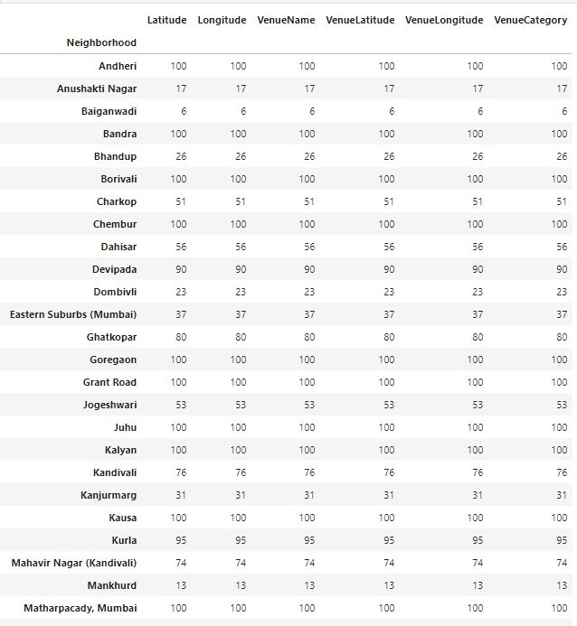
Number of venues in each neighborhood

Slide 6
Cluster formation
We using k-means cluster method to divide the neighborhoods of Mumbai.
Clusters are based on the frequency of occurrence for shopping malls.
Clusters divided into 3 parts.

Slide 7
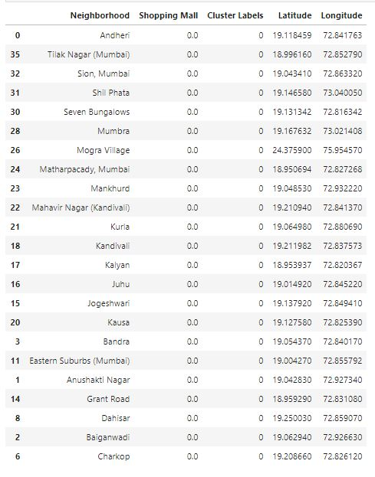
Cluster 0

Slide 8
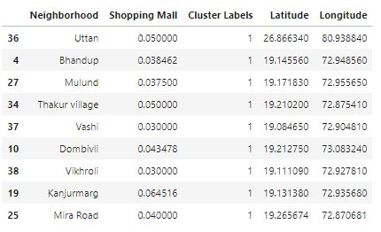
Cluster 1

Slide 9
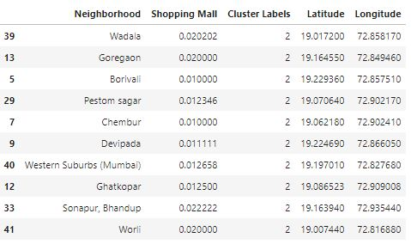
Cluster 2

Slide 10
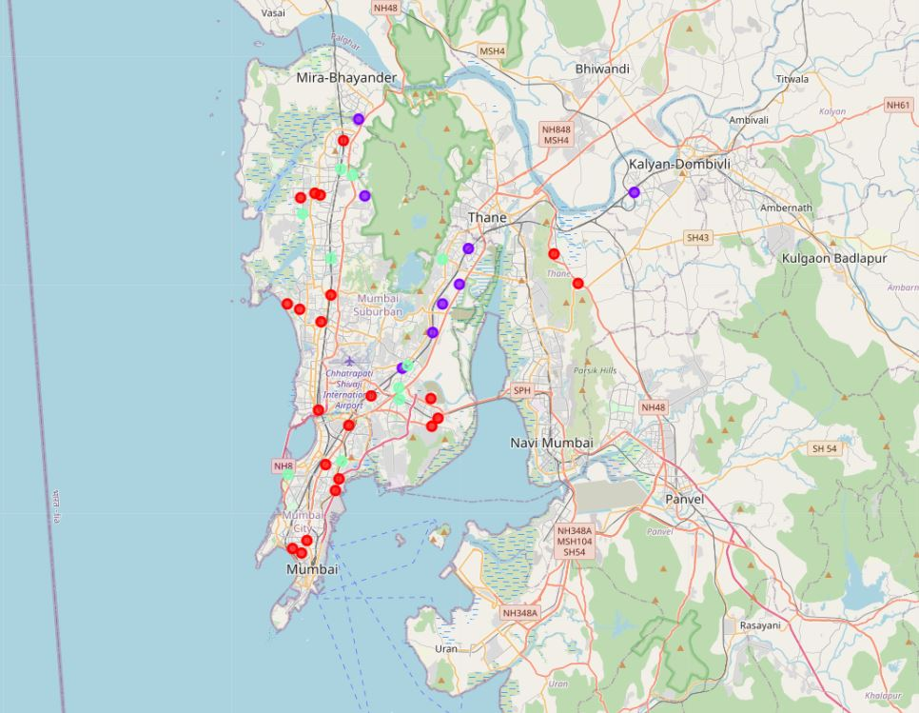
Clusters visualized in map

Slide 11
Cluster division
Red cluster (0): Neighborhoods with negligible to no number of malls.
Purple cluster (1): Neighborhoods with highest number of malls.
Green cluster (2): Neighborhoods with a moderate number of shopping malls.

Slide 12
Result
A. Cluster 1 will is overpopulated in terms of malls which causes intense competition. Developers are recommended to avoid these areas. These areas include mainly the western and a part of southern parts of Mumbai.
B. Cluster 2 is not over populated but the presence of competition will be noticed. Developers with new and innovative projects can be recommended this cluster to deal with the moderate competition.
C. Cluster 0 has negligible competition due to lack of malls. hence developers are strongly recommended to take advantages of these zones. These are the eastern and centrals parts of Mumbai.

Slide 13
Conclusion
In this project we use data science to answer the business problem stated in the start. We use create clusters based on the similarities in the property of frequency of occurrence to provide viable recommendations using the data.
To answer the question stated in the start of the project, the red cluster or cluster one is the most viable option to open a mall due to the lower concentration of shopping malls in the areas.

Slide 14
Thank You
Applied data science , capstone project

